Slide 1
BUSINESS
CASE ANALYSIS
SPEAKER: Ian Sinclair, Ian Sinclair Energy Management Consultant
NEXT UP

Slide 2
BUSINESS CASE
ANALYSIS
Ian Sinclair, P.Eng., Consultant

Slide 3
This Morning…
Interpreting audit results
One at a time, or one big bite?
Ways to view financial outcomes
Accounting 101
Combining with your bigger issues
1
2
3
4
5

Slide 4
1. INTERPRETING THE AUDIT
Two Key Documents…
#1: UTILITY BASELINE
Single-page summarizes baseline utility consumption & cost
#2: PROGRAM SHEET
Single document summarizes your energy audit’s output

Slide 5
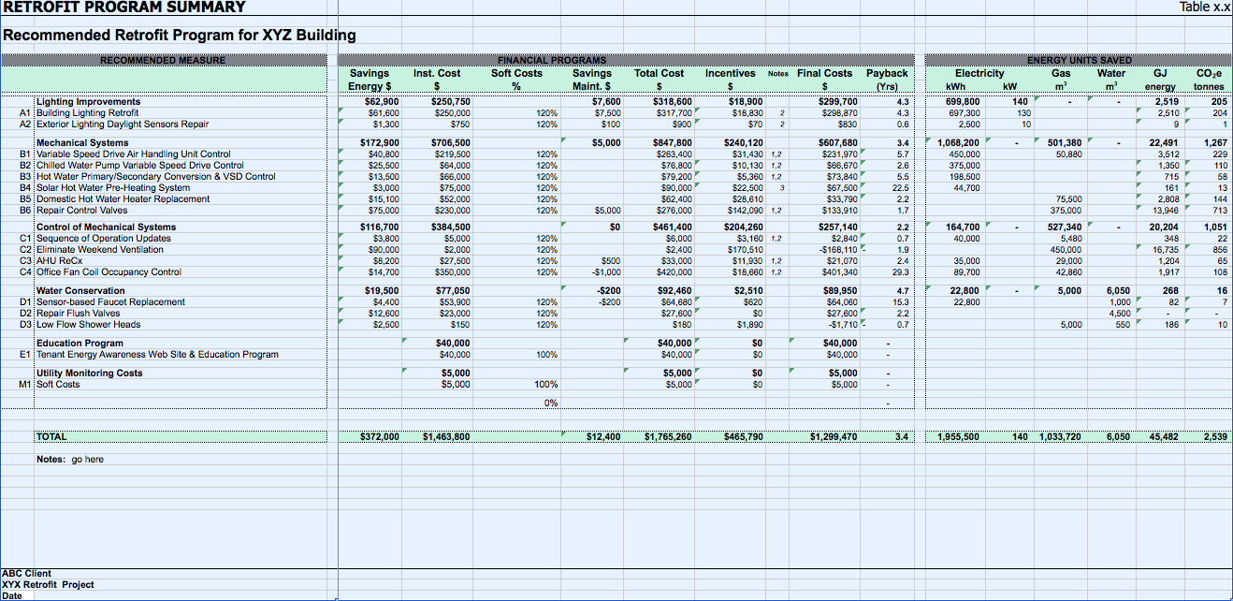
Utility Savings
Savings ($)
Costs ($)
Payback (yrs)

Slide 6
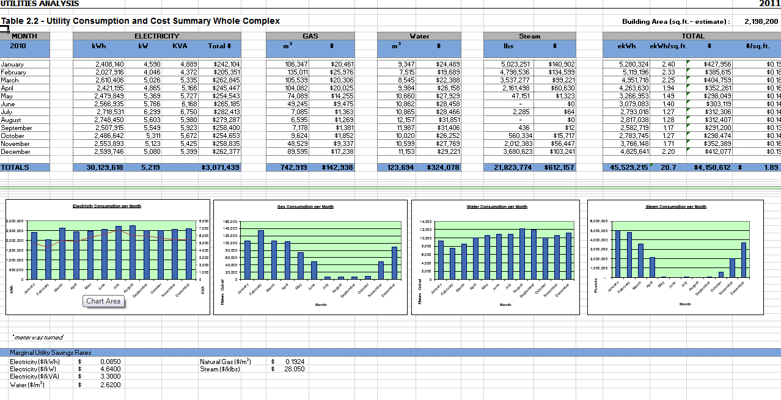
Key benchmarking inputs
Marginal savings rates

Slide 7
1. INTERPRETING THE AUDIT
Marginal Savings Rates
Key part of the energy audit is to identify the utility rate at which savings will ‘pay back’
Not the annual bill / annual consumption…..the cost that the saved kWh nets you
You need a rate to work with now and going forward, and an adjustment methodology in case that rate goes up and down (and it will). This is key literacy.
$ per kW, $ per kWh, $ per m³, $ per litre

Slide 8
1. INTERPRETING THE AUDIT
Percentage of What?
Program Summary both utility & financial. Examine carefully for sensitivity to rates.
Co-dependence of measures
Potentially a living document (measures in/out)
Remember also: maintenance savings/holidays, insurance savings, deferred capital expenditure, resulting alteration to corporate financial picture.
Opportunity costs….if you choose not to proceed

Slide 9
2. WHAT’S GOOD?
Determining Value
Simple payback not a “generally accepted” accounting valuation. Years, sounds like a long time.
Yet product will have a lifecycle. If simple payback < lifecycle, makes sense to invest.
Simple payback = Costs / Annual savings (# yrs)
But take the reciprocal,
Annual Savings / Costs = Return on Investment (% / yr)

Slide 10
2. What’s Good?
Return on Investment
(ROI)
Much more useful number. What’s your current ROI for money sitting in the bank? Your potential mortgage rate?
Invest based on most valuable outcome for financial sources

Slide 11
3. Assessing Success
Introducing Time
Must think about time. Why?
Equipment has a fixed lifetime
Money costs money when you borrow it
Accountants use depreciation to manage equipment replacements
Inflation….valuations reduce over time, yet savings’ value increases accordingly.
Need to understand accounting rules for your organization…and I am no CFA
Notes:
depreciation creates a loss that ensures you save for its replacement)

Slide 12
3. Assessing Success
Source of Money
Multiple routes in to finding money to spend:
1. Grant money
2. Borrow and invest, or
3. Have capital investment introduced via financial service offering (e.g. 3rd party financing, equipment lease, service provision)

Slide 13
3. Assessing Success
Introducing Borrowing Costs
If you borrow the money, must account for interest & how long you will pay it for
Back to the equipment’s lifecycle: borrowing is over a fixed time period (note: 20 years is often a time limit that accountants worry about exceeding)
Take same time period as the expected lifecycle of the equipment. If the ROI process is +ve to you after paying the interest by the end….seems a decent measure of success
Enter the spreadsheet…..

Slide 14
3. Assessing Success
Lifecycle Analysis – Declining Balance
Cost | $ 100,000
Annual Savings | $ 14,000
Annual Maintenance | $ 300
Inflation Rate | 1%
Cost of borrowed capital | 5%
 | Year
 | 1 | 2 | 3 | 4 | 5 | 6 | 7 | 8 | 9 | 10
Opening Balance | $ (100,000) | $ (81,385)
Income (Savings) | $ 14,000 | $ 14,140
Costs (Maintenance) | $ (300)
Interest Payment | $ (4,315)
Balance | $ (81,385)
Can make much more complex (depreciation value, tax implications, your input vs. borrowed input: equity/debt)

Slide 15
3. Assessing Success
Lifecycle Analysis
Cost | $ 100,000
Annual Savings | $ 14,000
Annual Maintenance | $ 300
Inflation Rate | 1%
Cost of borrowed capital | 5%
 | Year
 | 1 | 2 | 3 | 4 | 5 | 6 | 7 | 8 | 9 | 10
Opening Balance | $ (100,000) | $ (90,615) | $ (80,630) | $ (70,013) | $ (58,733) | $ (46,755) | $ (34,045) | $ (20,565) | $ (6,276) | $ 8,440
Income (Savings) | $ 14,000 | $ 14,140 | $ 14,281 | $ 14,424 | $ 14,568 | $ 14,714 | $ 14,861 | $ 15,010 | $ 15,160 | $ 15,312
Costs (Maintenance) | $ (300) | $ (315) | $ (331) | $ (347) | $ (365) | $ (383) | $ (402) | $ (422) | $ (443) | $ (465)
Interest Payment | $ (4,315) | $ (3,840) | $ (3,334) | $ (2,797) | $ (2,226) | $ (1,621) | $ (979) | $ (299)
Balance | $ (90,615) | $ (80,630) | $ (70,013) | $ (58,733) | $ (46,755) | $ (34,045) | $ (20,565) | $ (6,276) | $ 8,440 | $ 23,287
Our survey says yes!

Slide 16
3. Assessing Success
Third Party Funding
If someone else is borrowing money, be aware that cost of borrowing, profit motives have consequences to a project’s economics
Balance that cost against the fact they are potentially insulating you from risk & managing complex process on your behalf.
As the asset owner/host, your job is to be aware that ultimately you may end up being responsible for any acquired debt or risk. Be aware.

Slide 17
4. Other Names to Be Aware Of
Internal Rate of Return (IRR)
As I understand & interpret (engineer-alert!), we have just demonstrated IRR: this is your ROI after you’ve taken into account relevant factors to your financial situation
If the IRR > business as usual, this is a good outcome/measure
Cost of Capital
Utility Savings Inflation
Depreciation
IRR Over lifecycle

Slide 18
4. Other Names to Be Aware Of
Net Present Value (NPV)
NPV is looking to deal with inflation and cost of borrowing over investment lifecycle (pretty analogous to the IRR approach – need to know the rules of the game you are playing)
With NPV you are looking to come up with an overall positive valuation: was it better for your organization to invest, or use the money elsewhere?
If NPV of a stream of future income is positive – and the bigger the better (this is a real take home number), the answer should be ‘do it!’
Relies on notion that there is a ‘required’ or expected rate of return for your entity.
Connecting the two…..if the IRR is >= the do-nothing scenario to the organization, the NPV will be zero

Slide 19
5. Combining with the Larger Picture
Mitigating Current, Future Liabilities
Chances are you have a long-term capital picture that may have scary big numbers in the future
The overall asset plan (quantified hopefully via a Reserve Fund-type plan) has future liabilities
Make sure that the financial impact of an energy management intervention is captured now and into the future in order to see the big picture:
Future utility cost savings factored in and inflated in a justifiable way. This ‘income’ boosts the bottom line.
Future liabilities resolved today are removed from future burdens and capital can be freed up (spend now, save later)

Slide 20
THANK YOU
QUESTIONS?
CONTACT INFO:
Ian Sinclair
iansinclair@sympatico.ca
416-898-5383
Ian Sinclair, P.Eng., Consultant

