Slide 1
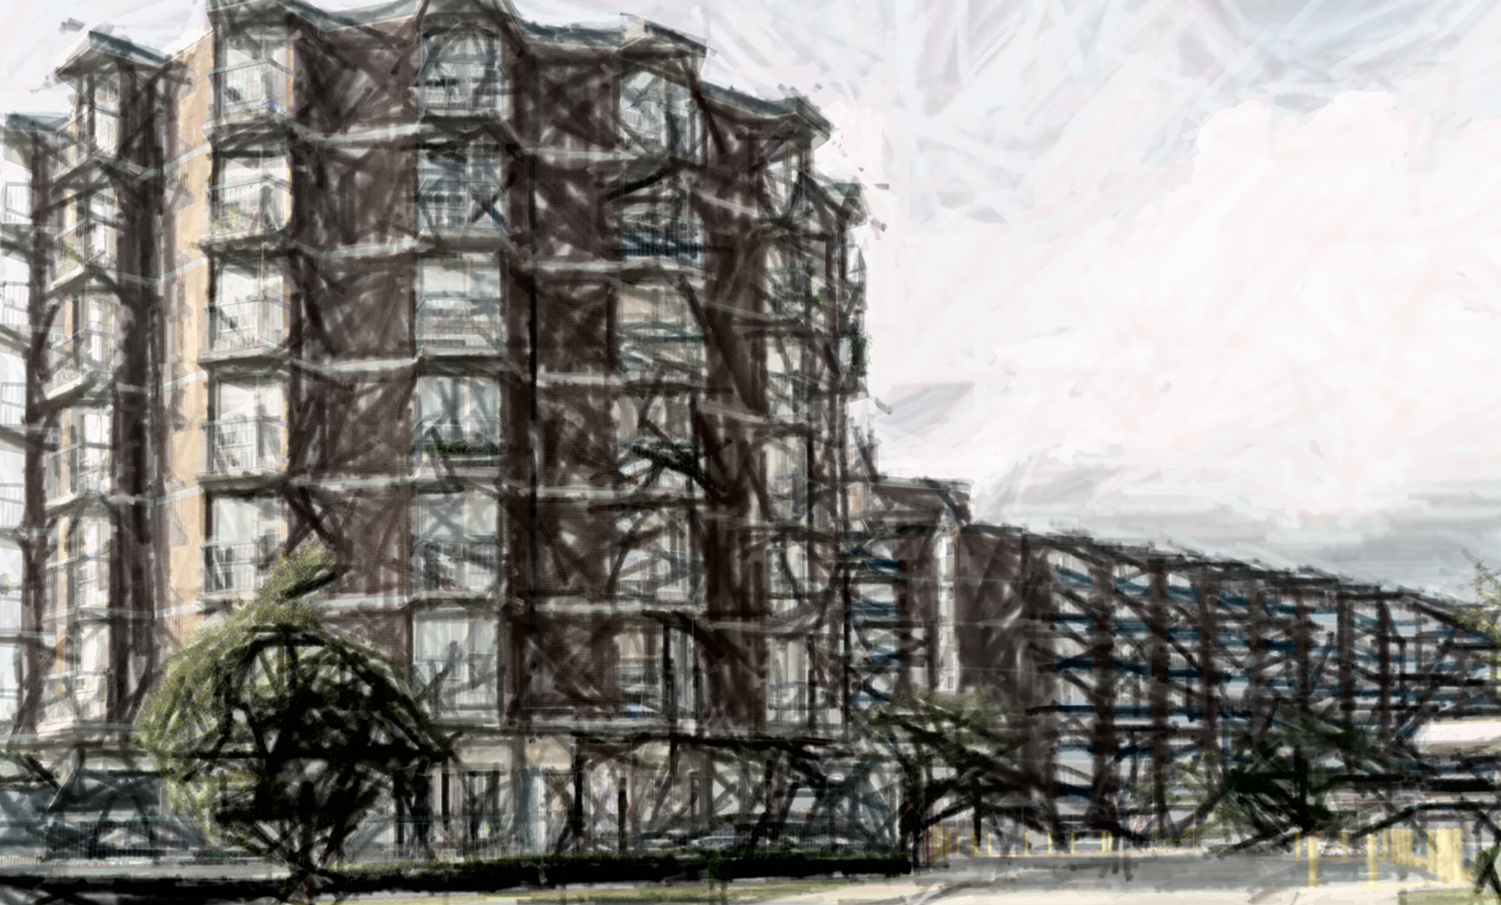
Funding Your Project
May 2022
matt@efficiencycap.com

Slide 2
Contents
Sources of Capital
Review of Sources
Stacking Case
1
2
3

Slide 3
Sources of Capital
EE Funding
Solutions
Traditional
Specialized
Equity
Utility Incentives
Savings Backed Arrangements
(3rd Party)
PACE / LIC
On-Bill
Loans/Leases
Funding Programs
Service Agreements (EaaS, ESA)
Energy Performance Contracting (ESPA)

Slide 4
Utility Incentives –
Funding Program | Eligible Measures | Study Funding | Capital Funding
Multi-residential | Boilers Water Heaters, Make-Up Air Units, Heat and/or Energy Recovery Ventilators | n/a | $ / unit, depending on efficiency
Affordable housing incentives |  | $8k/ bldg. or $40k/ provider | $100K to reduce payback $200K for prescriptive incentives free in-suite measures - showerheads & heat reflector panels
Notes:
Enbridge
study funding for SH providers only PER YEAR
Capital prescriptive measures
https://www.enbridgegas.com/business-industrial/incentives-conservation/programs-and-incentives/retrofits-custom-projects/affordable-multi-family-housing-program
IESO
no study
Capital prescriptive measures (x2 for SH adder)
Some of funding will come at install & some after 1yr M&V
Enbridge and IESO review programs add a couple split out private sector/resiedential

Slide 5
Utility Incentives –
Funding Program | Eligible Measures | Funding
Retrofit | Lighting and non lighting for MURBs and other facilities | (some) Lighting – Either $400/kW of demand savings or $0.05/kWh of 1st-year electricity savings, up to 50% project costs Non-lighting – Either $800/kW of demand savings or $0.10/kWh of first- year electricity savings, up to 50% of project costs
Energy Affordability Program | In-suite - led lights bulbs, power bars with timers, efficiency showerheads, aerators | Free
Audit funding | Electricity Survey Analysis Tenants Audits (lighting, office equipment & plug loads) Building Systems Audit (non lighting) | up to 50% of audit costs
Notes:
Enbridge
study funding for SH providers only PER YEAR
Capital prescriptive measures
https://www.enbridgegas.com/business-industrial/incentives-conservation/programs-and-incentives/retrofits-custom-projects/affordable-multi-family-housing-program
IESO
no study
Capital prescriptive measures (x2 for SH adder)
Some of funding will come at install & some after 1yr M&V
Enbridge and IESO review programs add a couple split out private sector/resiedential

Slide 6
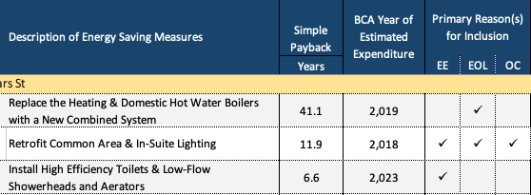
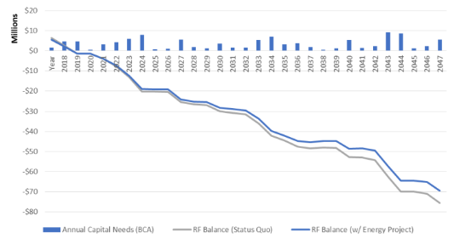
Equity (Reserves)
Business case for using reserve:
End-of-life in next ~5yrs
High internal costs for BAU
Significant non-monetary benefits
Compliance
Leverage external funding
Issues to manage:
Capital preservation – how much?
Regulatory/admin oversight on reserve allocation
Long-term capital plan & repayment into reserve?

Slide 7
Traditional Loans/Leases
Mortgage financing to include retrofit
Trigger events
Does the lender care about EE?
Loan to value pre or post retrofit?
Leases
Equipment lease or rentals
Issues to manage:
Borrowing bylaw
Borrower at risk if counting on savings
Notes:
Highly secured

Slide 8
Traditional Loans, Greened
Funder | Program | Key Notes
 | TD Green Banking | For business related renewable energy projects Loan term: 1-5 years fixed rate Amortization up to 30 years or useful life of assets financed
 | HSBC Green Loan Program | Green equipment financing, green loans Finance equipment acquisition with tangible environmental benefits
 | VCIB Clean Energy Financing | For energy efficiency projects Loan size: 3M-50M (project or portfolio) and 60%-80% debt financing of costs Loan term: 2-15 years, with amortization of up to 30 years
Notes:
RBC Energy Saver: https://www.rbcroyalbank.com/personal-loans/energy-saver-loan.html
Scoita EcoEnergy: https://www.scotiabank.com/ca/en/0,,4653,00.html#tab-features
TD: https://www.td.com/ca/en/personal-banking/solutions/green-banking/
HSBC: https://www.businesswire.com/news/home/20210928005051/en/HSBC-Brings-First-of-its-Kind-Sustainable-Finance-Product-Suite-to-Canadian-Businesses
Vancity: https://vancitycommunityinvestmentbank.ca/clean-energy-energy-efficiency-financing/?utm_source=Google&utm_campaign=SEMCleanEnergy&gclid=CjwKCAjwzOqKBhAWEiwArQGwaF6EfC3PRI2FYE_PyuYswVYmBpkGZlwUuIcHuV2bL6lIKnN0q9kO8RoCmUIQAvD_BwE#green_mortgage
Add more in key notes -, what can I use it for, on the mortgage, personal loan, terms interest rate, what can I use that for, scotia, building owner, it’s
VCIB - increase mortgage, are they doing something special - doing loan - commercial - up to 90, 95 - reditt - 3rd party -

Slide 9
Program-Specific Funding
Funder | Program | Planning / Study Funding | Capital Funding | Key Criteria | Term (yrs.)
 | Preservation Seed Funding | $50k/ study grant | up to $50,000 per project can be increased to $75,000 | Building, energy, operating viability, etc | n/a
 | Co-Investment Fund | N/A | 95% of costs Repayable + forgivable loan | Affordability (30%) Accessibility (5 units) Energy Efficiency | 10 + 10
 | Social Affordable Housing Retrofit | $25k plan grant $175k study grant | 80% of cost, up to $10M + 25-50% grant | Min 25% energy reduction | 25
 | Better Buildings Partnership | Some dev costs can be included | 100% of costs | NPV of savings greater than loan payments | 20
Notes:
CMHC – Seed – specifically for conducting assessments (more that EE)
CMHC – Co-Investment – retrofit = up to 40yr amm.
FCM – 20-30 year amm.
CHECK YOUR MUNI/REGION for latest innovation

Slide 10
Program-Specific Funding
Funder | Key Criteria | Capital Funding
Green and Inclusive Community Buildings | Community Centres, Public Sports and Recreational Facilities, Cultural Buildings, Mobile community infrastructure (e.g. health clinics, libraries, youth services), Community food banks, greenhouses, & Community health and wellness infrastructures | Continuous intake - $100K - $3M in total eligible costs. Scheduled intake - $3M - $25M Study costs can be capitalized
Notes:
CMHC – Seed – specifically for conducting assessments (more that EE)
CMHC – Co-Investment – retrofit = up to 40yr amm.
FCM – 20-30 year amm.
CHECK YOUR MUNI/REGION for latest innovation

Slide 11
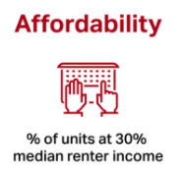
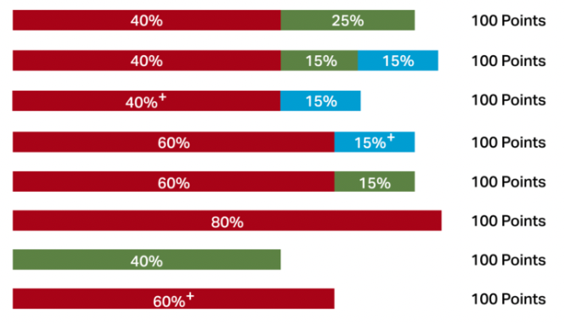
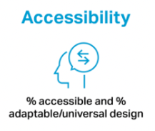
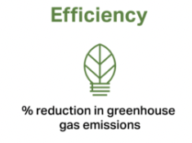
Green Mortgage Insurance
Notes:
www.canadaici.com

Slide 12
Canada Infrastructure Bank
$10B to invest in major energy efficiency initiatives
Provides financing for retrofits with a minimum of 30% GHG and energy savings
Criteria | Summary
Investment Size | Minimum $25 million
Building Types | The retrofits must be privately owned Commercial Buildings
Max Coverage | CIB will lend up to 80% of of the project value
Applicant Type | Building Owner Third Party Retrofit Aggregator
Term | 25 years
Rates | 1% - 3%
Notes:
CIB Bank:
- $10B plan to invest in major initiatives to create jobs and strengthen the economic growth
- Provides financing for decarbonized retrofits privately owned commercial, industrial and multi-unit buildings
- Investment opportunity must be a minimum of 25 million
- Two kinds of applicants
Building owners
Third party retrofit aggregators (ESCOs, new entrants to the energy services markets, C-Pace program administrators
https://cib-bic.ca/wp-content/uploads/2021/03/Retrofit-Program-Summary.pdf

Slide 13
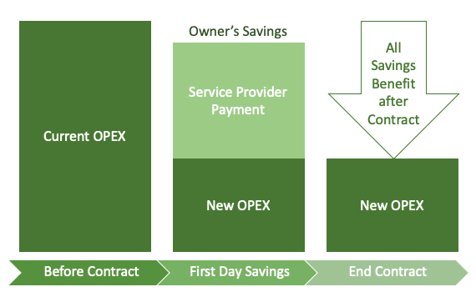
Savings-Backed Arrangements
3rd-party investment - savings pays for fees over time
Full risk transference/sharing
Expert partner can simplify extraordinary # of details
Notes:
Business case = same cost of extended warranties for 10-20 years

Slide 14
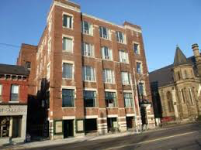
Fundraising – Community Bonds
Centre for Social Innovation (CSI) example
CSI outgrew leased space, needed to buy its own building
$6.8 M for purchase & renovations - no assets to leverage
Secured loan guarantee from City of Toronto = 75% mortgage of future building value instead of 65% of purchase price
Still needed $2M in equity - offered an RRSP-eligible Community Bond to network of supporters.
Notes:
Social capital into financial capital - Pioneer of the NFP community bond
No assets to leverage and practically no money
$6.8 million to purchase and renovate
VALUATIONS - 75% vs 65%
Raised $2M community bonds in equity to realize the project - RRSP-eligible investment opportunity to our network of supporters.
Very helpful guides
https://socialinnovation.org/impact/books/

Slide 15
What’s Required?
Utility Incentives
Equity
Traditional Loans
Funding Programs
Savings-Backed
Equity (2) Fundraising
Before/after process
Proof of install
Savings calcs
M&V Plan
Verification of savings
Business case for board approval
Oversight approvals
Title, appraisal, etc.
Borrowing bylaw
Eligibility?
*Post retrofit appraisal estimate
~ASHRAE II
Non-energy benefits (accessibility, affordability, etc.)
Ongoing monitoring & verification, reporting
ASHRAE III
Services contract
Monitoring & verification
Preventative maintenance
Behavior change
Same as 3rd Party, except investment contract
Fundraising efforts
Investment management over time

Slide 16
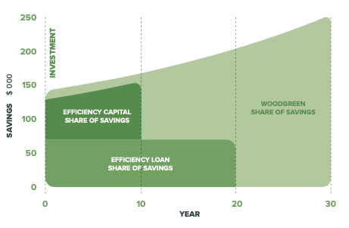
Stacking Example
3 sources of project capital
3rd Party – EC’s ESPA
Funding program - BBP Loan
Equity – Reserve loan
Unlocked mortgage financing

Slide 17
Funding Your Project
matt@efficiencycap.com
May 2022

